Slide 1
Cryptocurrency Transactions
UTXOs (Unspent Transaction Outputs)
wallets
Signatures: Public and Private Keys
Segregated Witness (SegWit)
Bitcoin Address
Hierarchically Deterministic (HD) Wallets

Slide 2
Transactions and UTXOs (Unspent Transaction Outputs)
John → Bob 0.1 BTC
Susan → Bob 0.3 BTC
Mark→ Bob 0.6 BTC
Peter → Bob 0.7 BTC
UTXOs stands for Unspent Transaction Outputs, they are different than what happen in the world of banking.
In a banking system once you set a transaction then the transaction is done and the transaction is recorded somewhere.
UTXOs

Slide 3
In Bitcoin the transaction lives on after it's been executed until another transaction (UTXO) is built out from that transaction.
After Bob received that money he wants to buy a camera for 0.5 BTC

Slide 4
John → Bob 0.1 BTC
Susan → Bob 0.3 BTC
Mark→ Bob 0.6 BTC
Peter → Bob 0.7 BTC
UTXOs
Bob needs to set up a transaction for that to happen.
Bob will not take just his money and use it, he needs to choose the transactions, and transactions live on until the UTXOs have been used up.
Bob needs to choose the transactions that he is going to link into the input.
So there are inputs where users can use to get the money.
Bob wants to buy a camera for 0.5 BTC
Transaction:
Input: Mark→ Bob 0.6 BTC
Output: 0.5 BTC to the Camera shop
0.1 BTC to Bob

Slide 5
In any cryptocurrency including Bitcoin, there is no account where an amount of money lying in.
In blockchain the money and movement of money is represented as a transaction(s) on the blockchain.
So Bob needs to go back to transactions and pick the transaction he wants, Bob picks the 0.6 BTC he received from Mark because it the closest to 0.5.

Slide 6
The transaction rule states that there cannot be unused inputs, so anything that goes into the input then the full amount has to go the output, basically there can be no change.
But we can send the change (difference) to a different participants, such as Bob himself.

Slide 7
John → Bob 0.1 BTC
Susan → Bob 0.3 BTC
Mark→ Bob 0.6 BTC
Peter → Bob 0.7 BTC
Input: Mark→ Bob 0.6 BTC
Output: 0.5 BTC to the Camera shop
0.1 BTC to Bob
UTXO for the Camera shop
UTXOs
UTXO for Bob
Now after that happens, the first transaction is finished and it’s no longer a UTXO since it fed the second transaction.
John → Bob 0.1 BTC
Susan → Bob 0.3 BTC
Peter → Bob 0.7 BTC
Bob → Bob 0.1 BTC

Slide 8
If Bob wants to buy a second camera for 1.1 BTC, what will happen?
Bob’s transactions now just sitting there and the only way they will come to an end is when they feed new transactions.
All new transactions go to the Blockchain, where new UTXO’s cancel previous UTXO’s, Bob now has one unspent transaction.
John → Bob 0.1 BTC
Susan → Bob 0.3 BTC
Peter → Bob 0.7 BTC
Bob → Bob 0.1 BTC
John → Bob 0.1 BTC
New UTXOs to the Camera shop
Transaction:
Input:
Susan → Bob 0.3 BTC
Peter → Bob 0.7 BTC
Bob → Bob 0.1 BTC
Output: 1.1 BTC → to the Camera shop
John → Bob 0.1 BTC
Susan → Bob 0.3 BTC
Peter → Bob 0.7 BTC
Bob → Bob 0.1 BTC
No UTXOs anymore

Slide 9
Where transactions fees come from?
Now assume that Bob has received more BTCs, Bob wants to buy a third camera for 0.9 BTC and an apple for 0.02 BTC.
In blockchain, not like the banking system, you can have multiple inputs and multiple outputs in one transaction
Transaction:
Input:
Mark→ Bob 0.4 BTC
Peter → Bob 0.3 BTC
Mark → Bob 0.3 BTC
Output: 0.9 BTC → to the Camera shop
0.02 BTC → to the fruit shop
0.06 → to Bob
Camera shop UTXOs
Fruit shop UTXOs
John → Bob 0.1 BTC
Susan → Bob 0.1 BTC
Mark→ Bob 0.4 BTC
Peter → Bob 0.3 BTC
Mark → Bob 0.3 BTC
UTXOs
Bob’s UTXOs
0.02 → to the Miner
John → Bob 0.1 BTC
Susan → Bob 0.1 BTC
Mark→ Bob 0.4 BTC
Peter → Bob 0.3 BTC
Mark → Bob 0.3 BTC
UTXOs
Miner UTXOs

Slide 10
The difference between the input UTXO value and the output UTXO value is not zero.
Anything that is not accounted for becomes the fees for this transaction to be included in a block in the blockchain.
If Bob wants his transaction to be selected among other transactions in the mempool, Bob has to pay fees for the miner. The higher the fee the more likely the UTXO will be selected.

Slide 11
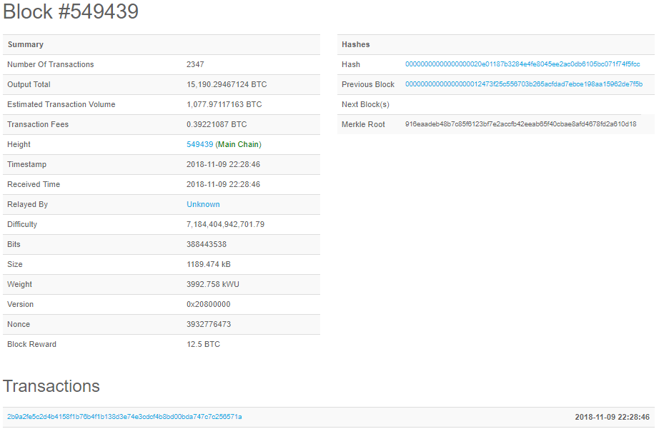
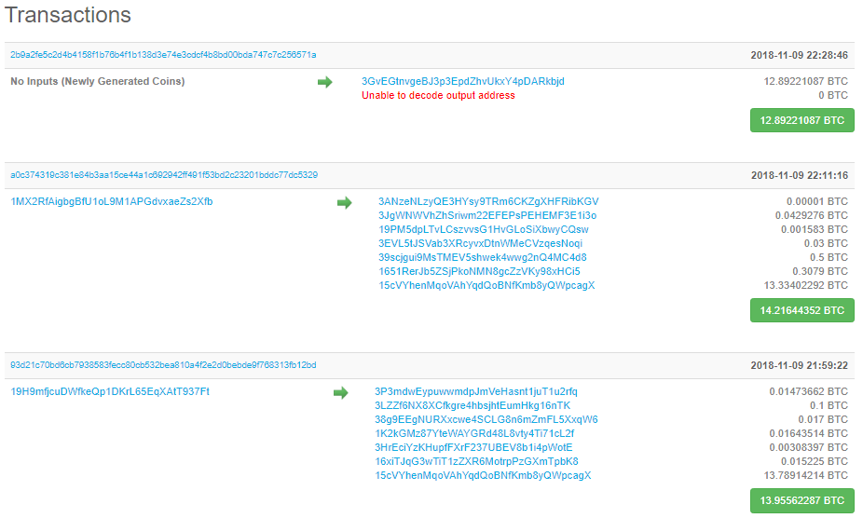
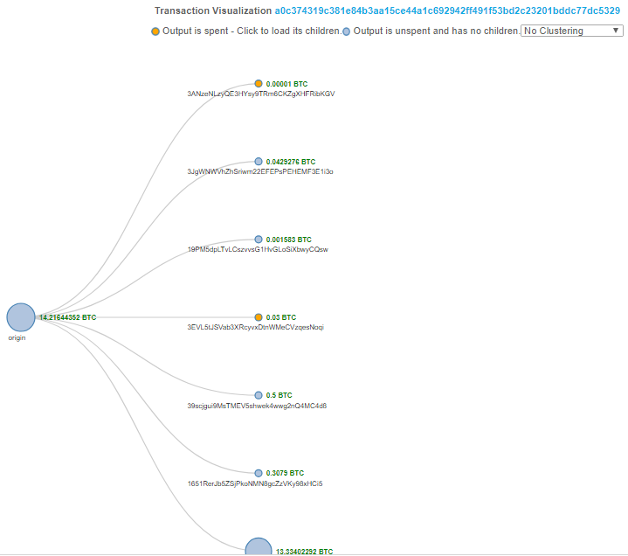
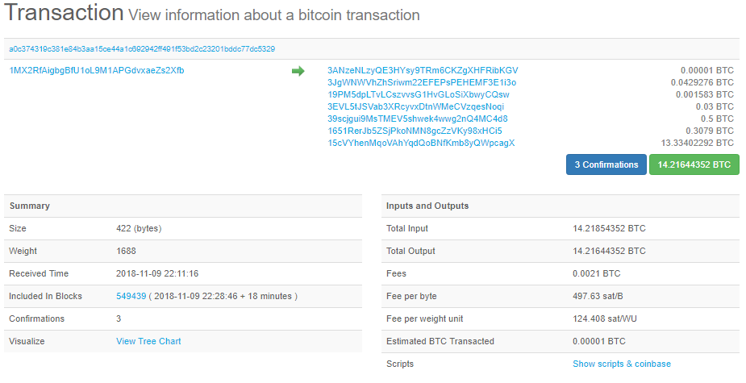

Slide 12
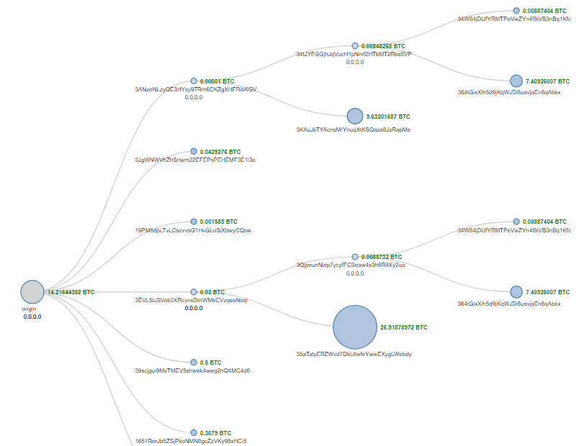

Slide 13
How Wallets Work?
A wallet calculates the total UTXOs that is available for the user and shows that value in the user’s balance.
In order for that to happen, the wallet need to go all over the transactions in the whole blockchain to find the remaining UTXOs for some user.

Slide 14

Bob → Camera shop 0.9 BTC
Bob → fruit shop 0.02 BTC
Bob→ Bob 0.06 BTC
Block 104
John → Bob 0.1 BTC
Susan → Bob 0.1 BTC
Mark→ Bob 0.4 BTC
Peter → Bob 0.3 BTC
Mark → Bob 0.3 BTC
Block 103
Bob→ Camera shop 1.1 BTC
Bob→ Camera shop 0.5 BTC
Bob → Bob 0.1 BTC
Block 102
Bob’s Wallet
0.1 + 0.1 + 0.06 = 0.26
John → Bob 0.1 BTC
Susan → Bob 0.3 BTC
Mark→ Bob 0.6 BTC
Peter → Bob 0.7 BTC
Block 101

Slide 15
What does the wallet do??
The wallet do the analysis on the linked blocks to identify all of the transactions which contain a certain user as an output of a transaction.
Then the wallet will check which of these transactions are still unspent transactions outputs (UTXOs), add their values and this represents the user current balance.
In reality this money is not stored physically somewhere as a Cryptocurrency, they don't exist on a paper. There's no coins as in banks.

Slide 16
Signature: Private & Public Keys
How blockchain ensures the privacy of the users?
In transactions, anyone can know who send money to whom, and how much.
Every user that uses cryptocurrency, he\she is assigned a private key.
A private key represents the unique identifier of the user and it is not shared with anyone (like the password used in a bank account).
Then from the private key the user can generate a public key which can be shared with others.
The user shares his public with other users so that the user can send and receive money.

Slide 17
If a user want to send a cryptocurrency (transaction) to another user, then he will use his private key and the transaction to create a signature for the transaction, then the signature will be attached to the transaction.
Since no one knows the private key except the owner of the transaction, then no one can change the transaction and yet generate the original signature.
On the other side, when the receiver receives the transaction and the signature attached to it, the receiver will validate this combination to make sure that this is a valid transaction generated by your private key.

Slide 18
To do so, the receiver will use a verification function that takes three inputs:
1) the transaction
2) the signature
3) the senders public key.
The verification function will result in YES if the transaction was signed using a private key that was also used to generate the public key, otherwise the output will be NO; which means the transaction or the signature or both were tampered with.
Even though the public key was generated from the private key, no one can reverse the public key to extract the private key.

Slide 19
Private Key
Public Key
YES
Transaction
Verification Function
Signature
NO

Slide 20
When the user sends his transaction to the mempool in order to selected by miners, and then added to the blockchain, the user must attach the signature and his public key along with the transaction, and this allows the miners and other nodes in the network to verify that indeed the transaction was initiated by the person who holds the private key.

Slide 21
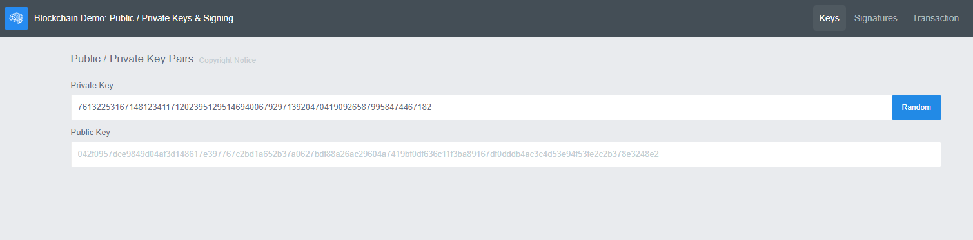
Signatures and Keys Demo
https://tools.superdatascience.com/blockchain/public-private-keys/keys

Slide 22
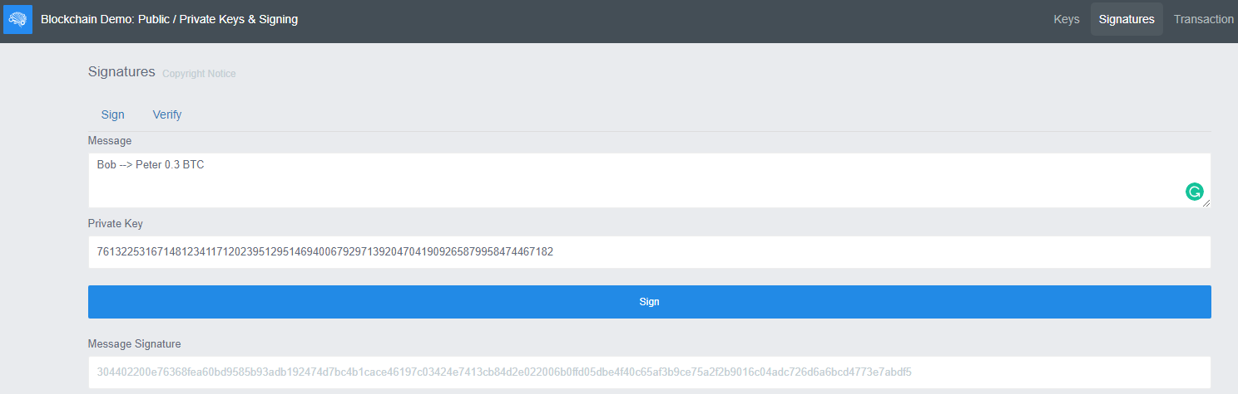
The public key is a fixed length key that is derived from the private key. Its recommended to choose a non trivial or short private key for security reasons.
A message is signed using the private key, the output is a signature which will be attached to the message along with the sender’s public key.

Slide 23
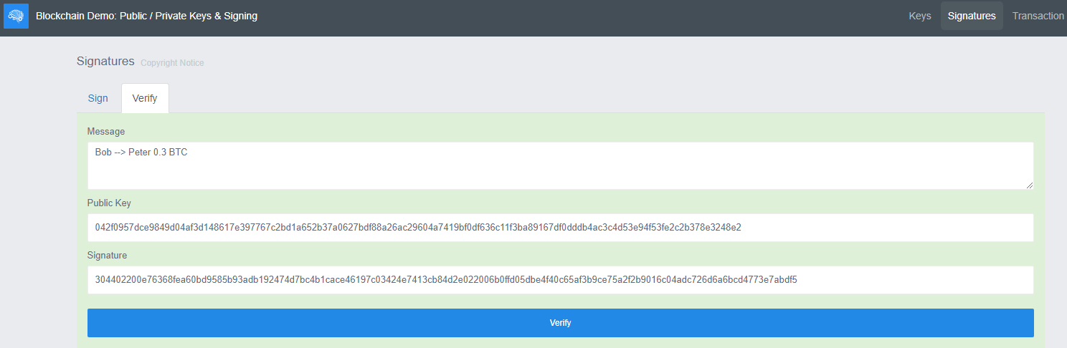
The receiver can verify the authenticity of the message using the senders public key.
If the public key of the sender (derived from the sender’s private key), the signature, and the message were authentic, the transaction is considered valid.

Slide 24
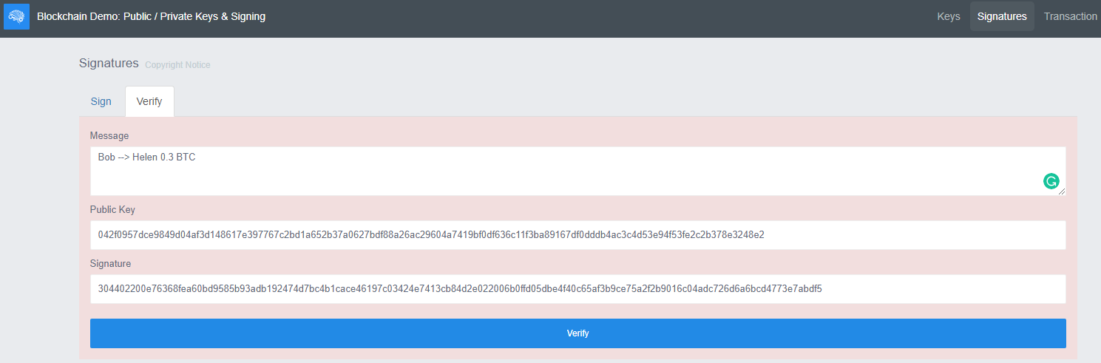
If someone tampers with message, the signature, or the public key, then the transaction is considered invalid.

Slide 25
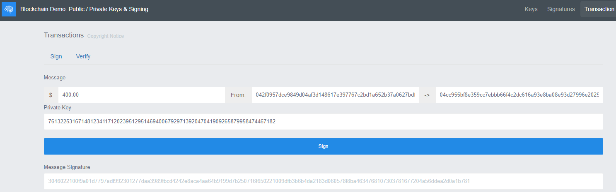
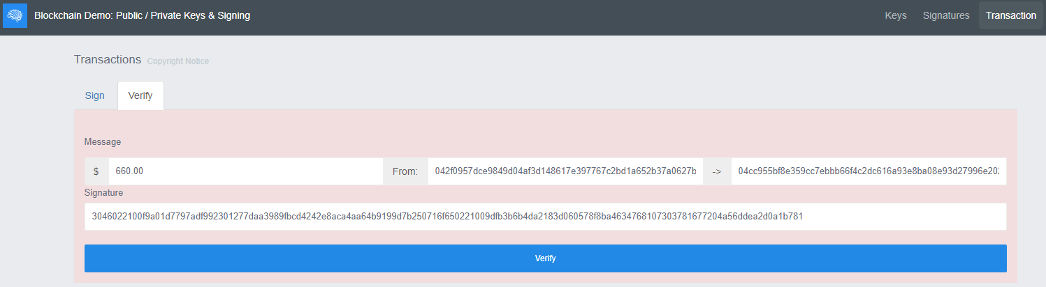

Slide 26
Segregated Witness (SegWit)
All the information inside the block except the transactions are called the block header.
In BTC the limit of the block size is 1 MB. It was selected in the original design to prevent slow transacting between the users. In case the size was too small then the number of transactions that can be included in the block will be small too, hence, people will be waiting for long time to transact.
Block: #400,120
Timestamp: 1425691478
Nonce: 620877
Transactions: 125A55B52C65656565F56A58B 35C897E65D215AA36C54F1482 6C8B7E9F4124578D6582A3268 45265897A25E566F45B149E5B 8A56D98744562D6544FF475E1
Prev. Hash:000054E68A98B21C
Hash:00009A5B4C3F6E11B2A6
1 MB

Slide 27
Since all users share the same copy of the blockchain, if the chosen size of the block was greater than 1 MB, then the network will be slow.
If the blockchain size is very large and hence the network is slow, then more orphaned blocks will appear, more competing chains will appear, and the blockchain is more prone for attack due to the slow propagation of the information in the network.

Slide 28
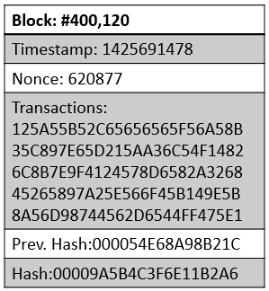
Also, after the Blockchain has been working for some time, the users of the blockchain network started to face slowness while transacting. This is due to the increased number of users and transactions.
There are some solutions to increase the bandwidth of the blockchain, and this will allow more users and transactions to be involved while keeping the speed of transacting reasonable.
125A55B52C65656565F56A58B
From: X
To: Y
Amount: 0.3 BTC
Public Key: <…….>
Signature: <…….>

Slide 29
Soft Fork (Segregated Witness)
Soft Fork is an upgrade on how the blockchain works, but it is not compulsory for every node to employ.
In this solution, both the public key and the signature which represent a witness for each transaction are segregated out of the transaction.

Slide 30
In any transaction, 60% of the transaction size is occupied by the signature and the public key (scriptSeg).
Although the transaction purpose is to show the sender and the receiver and the amount of the transaction between them, 60% of the transaction size goes for the public key and the signature for securing the transaction and for preventing any forged data.
What was proposed is to remove the scriptSeg part from the message and send it separately using the messaging service through the network.
125A55B52C65656565F56A58B
From: X
To: Y
Amount: 0.3 BTC
Public Key: <…….>
Signature: <…….>

Slide 31
Still, the public key and the signature will be linked to each block and transaction but it will go through the network separately.
This way more space is available, each block size will be reduced substantially and can fit more transactions.
Segregated Witness is backward compatible meaning that even nodes that didn’t deploy SegWit, they still participate in the blockchain network.

Slide 32
Segregated Witness solution didn’t increase the block size to more than 1 MB.
Since the scriptSeg was removed out from the block, more transactions can be included which looks like the block size increased but in reality the number of transactions increased not the size of the block.

Slide 33
Not only BTC utilized SegWit, other cryptocurrencies such as Light Coin used the same technique.
The main disadvantage about BTC (based on Blockchain) is that they are slow when compared with visa and MasterCard transactions.
BTC can now perform 10 transactions per second, while visa and MasterCard can do 10’s or 100’s of transactions per second.

Slide 34
Public Key vs Bitcoin Address
Bitcoin address: is derived from the user’s public key by applying the SHA-256. Since the SHA-256 is a deterministic function, every public key will have its own unique bitcoin address.
The address is used for receiving money from other users as just with the public key, so its not hidden when compared with the private key.
The user can receive BTC using his public key or his bitcoin address.
The reason for having the bitcoin address, is that it is used to minimize exposing the public key when its possible. The idea is to keep the public key protected as much we can.

Slide 35
Its mandatory to expose the public key when X sends money to Y, Y will use X’s public key to run the verification function so that Y can confirm that the transaction is valid.
Why should we avoid exposing the public key when we can?
The public key is generated from the private key using an elliptic function, there's no way to identify what is the private key knowing the public key until now.
But assume that in the future some one can do that, then having the bitcoin address which is derived from the public key adds a layer of protection.

Slide 36
The bitcoin address is derived from the public key using SHA-256, which is different than the elliptic function.
If the private key was compromised by reversing the public key in some way, then at least not all the transactions of the user is labeled by the public key.
The bitcoin address decreases the chances to compromise every thing that belongs to a specific user who’s private key was compromised.

Slide 37
Private Key
Public Key
Bitcoin Address
YES
Transaction
Verification Function
Signature
NO
If Y wants to send money to user X, then Y will use X’s Bitcoin address in the transaction to represent the destination.

Slide 38
Hierarchically Deterministic (HD) Wallets
Cryptocurrency is meant to be anonymous, so blockchain should be anonymous too.
But in reality cryptocurrency is not exactly anonymous but its pseudonymous.
As long as no one knows to whom a private key is attached, then no one knows the owner.
Cryptocurrency is not completely anonymous because if the private key of someone was exposed meaning the identity of the private key owner is revealed then we will know everything about the transactions of the private key owner.

Slide 39
If a user wants to receive BTC then that user should give his BTC address, but if the user wants to send BTC, then the public key of that user should be attached to the transaction.
This means if someone is searching for information inside blockchain transactions, then a pattern could be found easily between the BTC address and the public key.

Slide 40
To decrease the possibility of finding such patterns and as a result maintaining the privacy of the users, the user can have multiple private keys, which means multiple public keys generated from these private keys, and also multiple bitcoin addresses generated from the public keys.
Private Key
Public Key
Bitcoin Address
Private Key
Public Key
Bitcoin Address
Private Key
Public Key
Bitcoin Address
Private Key
Public Key
Bitcoin Address
Private Key
Public Key
Bitcoin Address

Slide 41
For each transaction, the user can generate new public key and a new BTC address.
This way the possibility of finding patterns between public keys and BTC addresses is reduced if the user maintains using different public keys and BTC addresses while he is transacting in the network.

Slide 42
But maintaining the different private keys safe, and keeping track of the associated public keys and the BTC addresses is hard and not easy task.
As a solution for this problem, Bitcoin introduced the BIP 32 (Bitcoin Improvement Proposal).
The BIP 32 solution is the Hierarchically Deterministic (HD) Wallets. The HD wallet assigns a master private key for the user, and from the master private key, a private key is generated, and from this private key a public key is generated, and finally a BTC address is generated from the public key.
The master private key and the private key are kept secured and not shared with any one.

Slide 43
The user now can generate a new private key by simply incrementing the master key by one and the hash function will be used to generate the new private key, which in turn will be used to generate a new public key which is also used to generate a new BTC address.
This process could be repeated as many times the user needs a new set of public key and BTC address for transacting.
The advantage of the HD wallet is that it will keep a record of your generated private keys and their associated public keys and BTC addresses, the user don’t have to keep a record for all generated key, as long as the master private key is there in the wallet.

Slide 44
Also the HD wallet will do this job automatically every time the user is sending or receiving money, different public keys and different BTC addresses will be used, and by this the privacy of the user is maintained.
Master Private Key
Private Key
Public Key
Bitcoin Address
+1
Private Key
Public Key
Bitcoin Address
+2
Private Key
Public Key
Bitcoin Address
+3
Bitcoin Address
Private Key
Public Key
+4
Bitcoin Address
Private Key
Public Key

Slide 45
Moreover, the owner of the master private key either as a person or a company can track any transaction in the blockchain whatever the public key or BTC address that was used.
The owner of the master private key can track any transaction that took place using any public key or BTC address which was generated from a private key which in turn was generated from the master private key that belongs to the owner.

Slide 46
This hierarchal structure of the keys make it easy to transact while maintaining the privacy, and also its easy to track any transaction originated from the wallet that has the master private key.
If a company consists of different divisions, the manager can assign one of the private keys to each division, that division can track any transaction related to their private key, but they cant track other divisions transactions since the division only has one private key.
The owner of the master private key can track all transactions because that owner knows about all private keys.

Slide 47
Another addition by the BIP 32 is to have a master public key which is generated from the master private key.
Master Private Key
Private Key
Public Key
Bitcoin Address
+1
Private Key
Public Key
Bitcoin Address
+2
Private Key
Public Key
Bitcoin Address
+3
Private Key
Public Key
Bitcoin Address
+4
Private Key
Public Key
Bitcoin Address
Master Public Key

Slide 48
The owner of the private key may hire someone to help him track his transactions, for example for auditing, but on the same time the owner does not want this auditor to send BTCs from his wallet.
In this case the master public key could be used to recreate the public keys, by doing this, the auditor can track any transaction sent or received from the owner’s wallet, but he don’t have the master private key or any of the private key which may be used to send BTCs.

Slide 49
How to Keep the Master Private Key Safe
The wallet provider will prompt the user to create a mnemonic which consists of 12 words and the provider will ask the user to write it down on a paper and keep it somewhere safe.
The mnemonic is used to generate master private key.
It is very unlikely that two people will have the same mnemonic and therefore the same master private key.

Slide 50
If the user lost his password, or the servers of the provider got destroyed, or the user lost his master private key, then the mnemonic will be used to regenerate the master private key using the provider’s algorithm.
This way the private keys could be recreated again, also the public keys, and the BTC addresses, everything can be restored completely just from the mnemonic.

